Slide 1

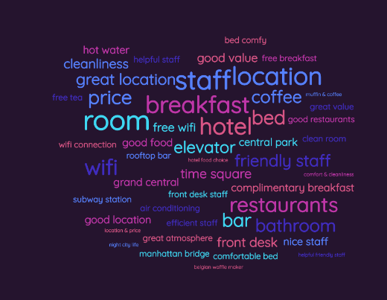
Natural Language Processing(SWE1017)
Disaster Tweets NLP: EDA & BERT With Transformers
THE NAME OF THE COMPANY
kaggle compitition
Team Members
20MIA1031 - SANJAY.M
20MIA1117-PILLARAM MANOJ
20MIA1162 - GUNA SHANKAR.S

Slide 2
Dataset
Description
Application
THE NAME OF THE COMPANY
METHOD
Algorithm
IMPEMENTATION

Slide 3
ABSTRACT
Natural Language Processing (NLP) has become increasingly popular due to its diverse range of applications, including disaster management. Social media platforms like Twitter are commonly used to disseminate real-time information during emergencies, and many businesses are considering automating Twitter tracking to identify disaster-related tweets. This study presents a method for using deep learning models such as BERT (Bidirectional Encoder Representations from Transformers) and Exploratory Data Analysis (EDA) to categorize disaster-related tweets. The research includes conducting EDA on a publicly available dataset of disaster-related tweets to analyze data distribution, class imbalance, and tweet length. Fine-tuning the pre-trained BERT model on the disaster tweet dataset, and evaluating its performance using standard metrics such as accuracy, precision, recall, and F1-score to identify whether a particular tweet is related to a real disaster or not. A competition dataset has been collected for this purpose.
THE NAME OF THE COMPANY

Slide 4
INTRODUCTION
NLP has various applications, including disaster management, where Twitter is used to disseminate real-time information. However, manually categorizing disaster-related tweets is time-consuming, and there's a need for automated methods. BERT, a pre-trained deep learning model with transformer architecture, has shown impressive results in various NLP tasks. In this study, we explore the use of BERT for categorizing disaster-related tweets. EDA is conducted on a publicly available dataset of disaster-related tweets to gain insights into the data. The pre-trained BERT model is fine-tuned on the dataset and evaluated using standard metrics. The research aims to provide an accurate and efficient method for categorizing disaster-related tweets using BERT, which can help emergency responders provide timely and effective assistance during disasters.
THE NAME OF THE COMPANY

Slide 5
OBJECTIVE
The objective of this project is to explore the use of BERT with transformers for categorizing disaster-related tweets in an accurate and efficient manner. The project involves conducting Exploratory Data Analysis (EDA) on a publicly available disaster tweet dataset to gain insights into the data distribution, class imbalance, and tweet length. The pre-trained BERT model is fine-tuned on the disaster tweet dataset, and its performance is evaluated using standard metrics such as accuracy, precision, recall, and F1-score. The ultimate goal of this research is to provide a method that can automate the categorization of disaster-related tweets, which can help emergency responders to provide timely and effective assistance during disasters.
THE NAME OF THE COMPANY

Slide 6
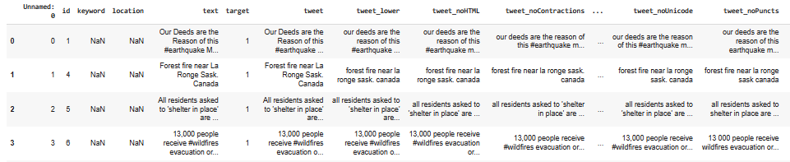
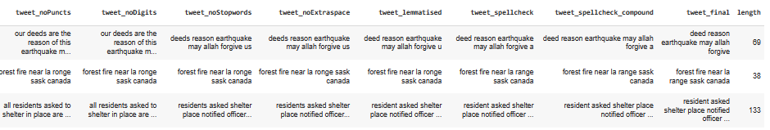
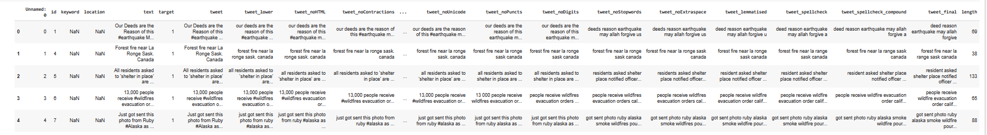
Dataset Description
THE NAME OF THE COMPANY

Slide 7
Dataset Description
The text of a tweet
A keyword from that tweet (although this may be blank!)
The location the tweet was sent from (may also be blank)
80%
train
20%
train-test
30%
testing
THE NAME OF THE COMPANY

Slide 8
Application
Emergency Alerts
Disaster Response
Political Action
Early Warning Systems
THE NAME OF THE COMPANY
Public Safety Alerts
Disaster Research
Media Coverage
Crisis Communication
Fundraising

Slide 9
METHOD
file:///C:/Users/mural/AppData/Local/Microsoft/Windows/INetCache/IE/0QAE0HXS/DICE_UPB.IS%20(1)[1].pdf
https://www.warse.org/IJATCSE/static/pdf/file/ijatcse06911sl2020.pdf
S.no | Authors | Title | Abstract | Journal Name, Year | Data set | Methodology | performance measure
1 | Hamada M. Zahera | Fine-tuned BERT Model for Multi-Label Tweets Classification | They has conveyed that describe method for categorising disaster-related tweets into multiple label information types (i.e, labels). During disasters, they aim to filter the most relevant tweets first. Then we assign relevant information types to tweets. SearchAndRescue, MovePeople, and Volunteer are examples of information types. We use a refined BERT model with ten BERT layers. In addition, we submitted our approach to the TREC-IS 2019 challenge, and the evaluation results revealed that our approach outperforms the F1-score of median score in identifying actionable information. | 2019 | TREC-IS Dataset | Fine-tuning BERT | 0.85
2 | Gleen A. Dalaorao, Ariel M. Sison | Applying Modified TF-IDF with Collocation in Classifying Disaster-Related Tweets | They conveyed that Disaster-related tweets classification refers to posted tweets on twitter during time-critical events that are group together according to pre-defined categories. The Term Frequency – Inverse Document Frequency (TF-IDF) helps classifier extract useful features, but it can be ambiguous and can reduce classification efficacy. This paper aims to provide an analysis of the effectiveness of tweets classification by applying improved TF-IDF with collocation. The performance evaluation metrics considered are confusion matrix, precision, recall, and F1 score. | 2020 | Crisislex dataset | TF-IDF Collocation Weight Processing, RandomForest, Multinomial Naive Bayes and SVM | 0.87
THE NAME OF THE COMPANY

Slide 10
Algorithm
LR
SVC
KNN
SVM
The BERT (Bidirectional Encoder Representations from Transformers) model is a Google-developed pre-trained deep learning algorithm for natural language processing tasks. It is an effective text classification and language translation tool. The BERT model is used to categorise tweets as disaster or non-disaster tweets. To adapt to the specific classification task, the BERT model is fine-tuned on training data.
BERT
THE NAME OF THE COMPANY
The BERT model and the TF-IDF vectorizer are both effective text classification tools.The BERT model is more complex and requires more computational resources than the TF-IDF vectorizer, but it can be more accurate.
TF-IDF
The TF-IDF vectorizer (Term Frequency-Inverse Document Frequency) is a popular feature extraction tool in natural language processing. It is a statistical method for determining the significance of a word in a document based on its frequency and the number of documents in which it appears. The TF-IDF vectorizer is used to convert tweets into numerical feature vectors. The TF-IDF vectorizer assigns a score to each word in the corpus based on its frequency in a specific tweet and its overall frequency in the corpus.

Slide 11
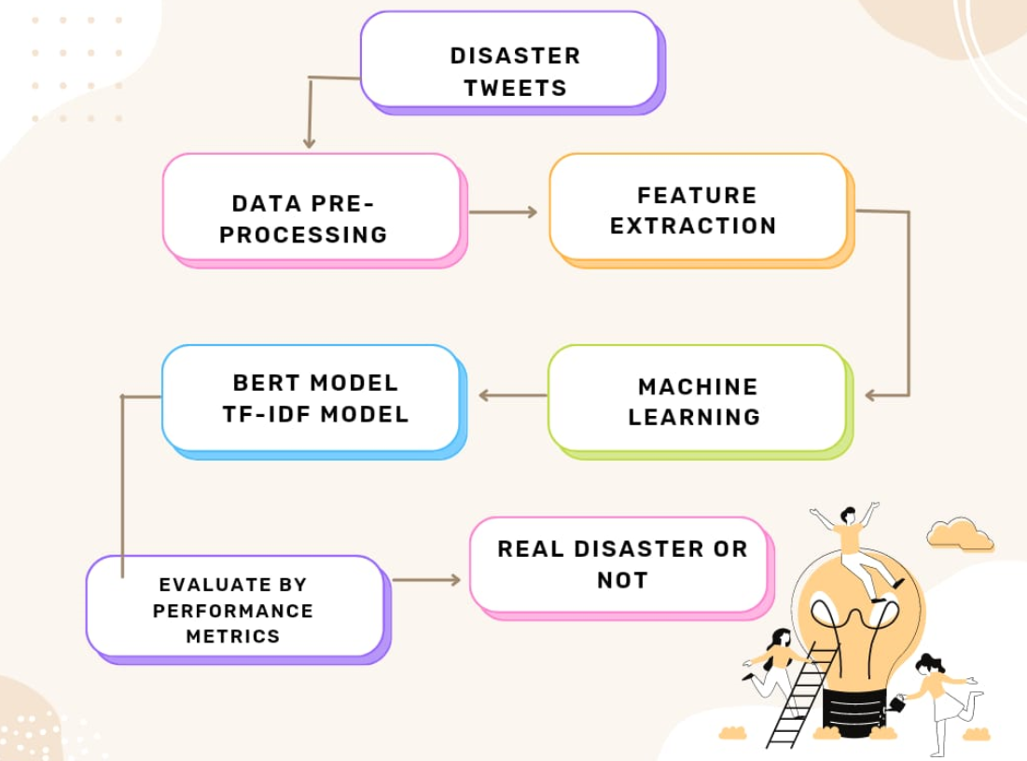
Methodology
Exploratory Data Analysis (EDA)
Data Preprocessing and Data Exploration
THE NAME OF THE COMPANY
Feature Extraction
Model Building

Slide 12
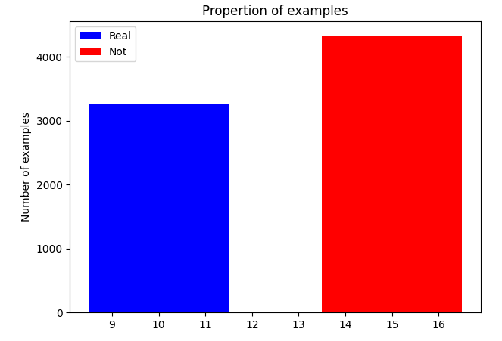
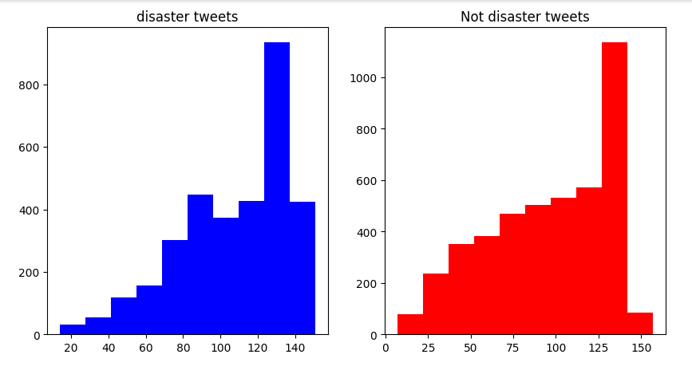
EDA
The above bar chart represents the computing the number of instances of each class. The blue color represents whether the disaster is real and the red color represents the disaster is not a real.
THE NAME OF THE COMPANY
The above Histogram represents the disaster tweets and Not disaster tweets. Disaster tweets represents in blue color and Not disaster tweets represents in red color.

Slide 13
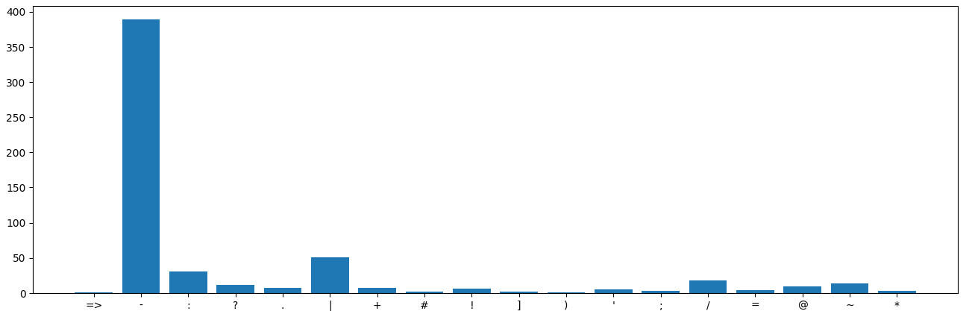
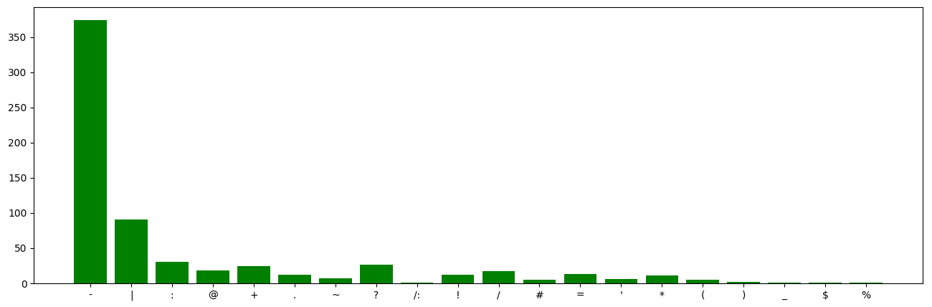
Character count
CLASS-0
THE NAME OF THE COMPANY
CLASS-1

Slide 14
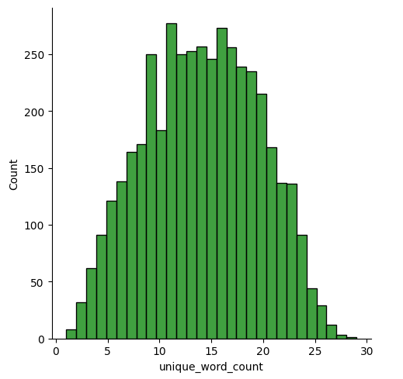
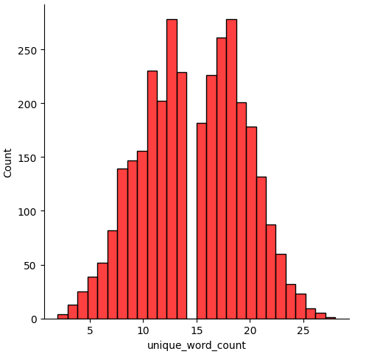
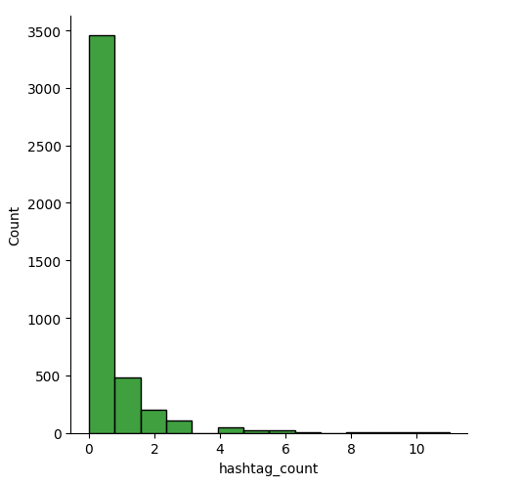
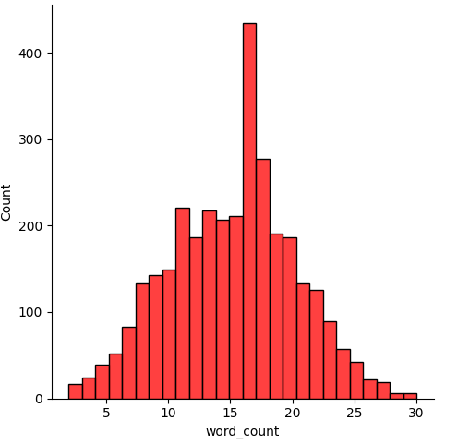
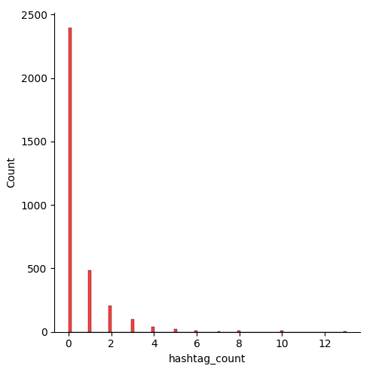
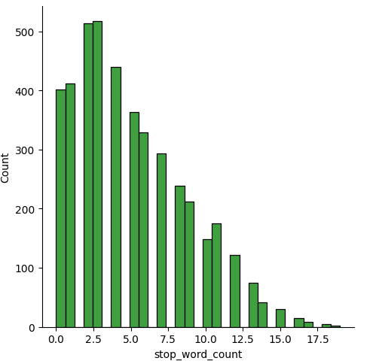
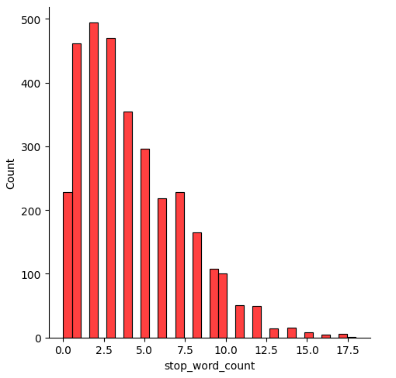
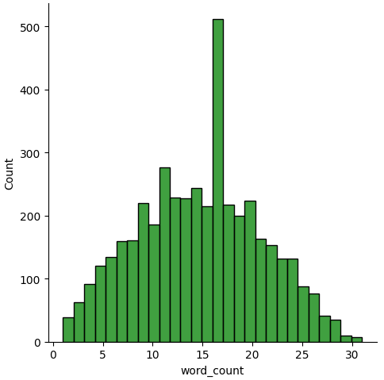
word_count
hashtag_count
unique_word_count
stop_word_count
THE NAME OF THE COMPANY

Slide 15
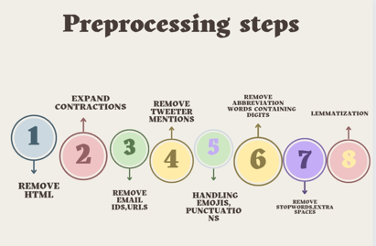
Data Preprocessing
THE NAME OF THE COMPANY

Slide 16
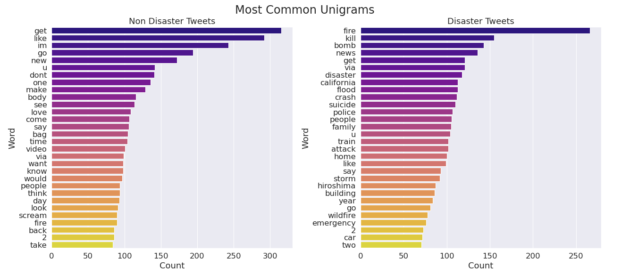
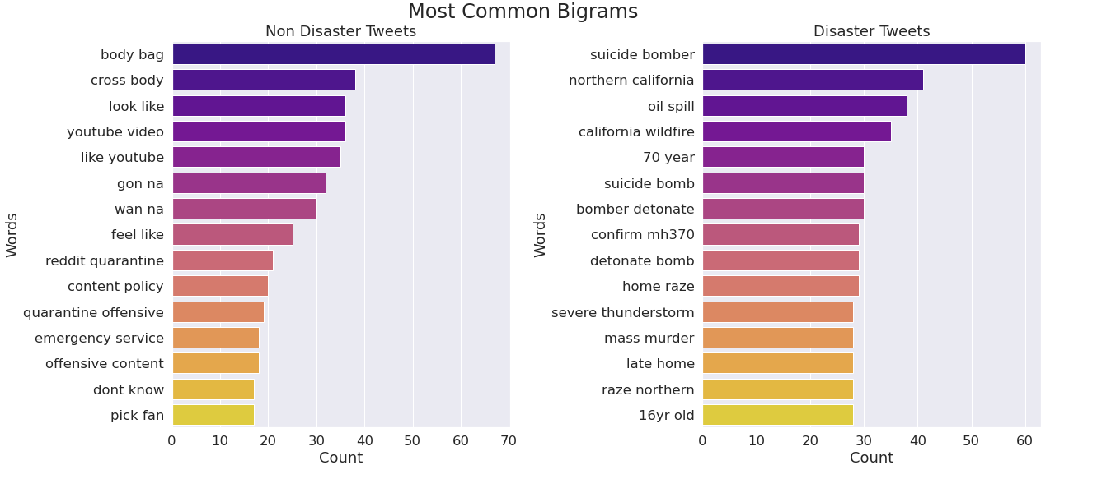
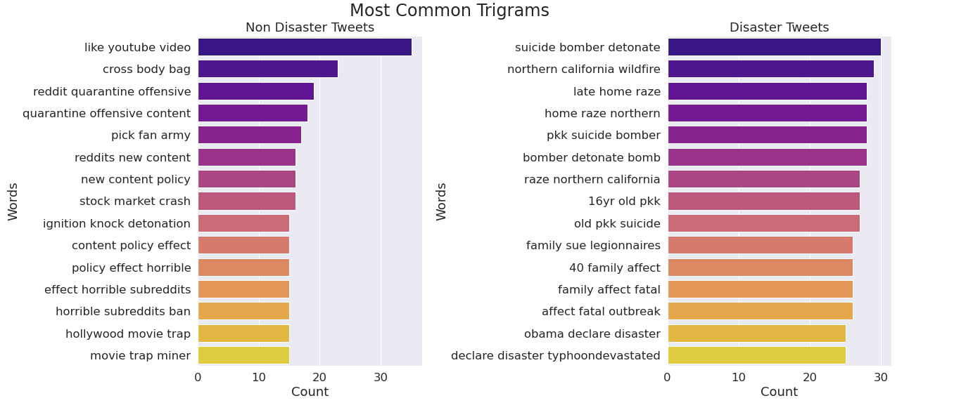
N-GRAM Analysis
THE NAME OF THE COMPANY

Slide 17
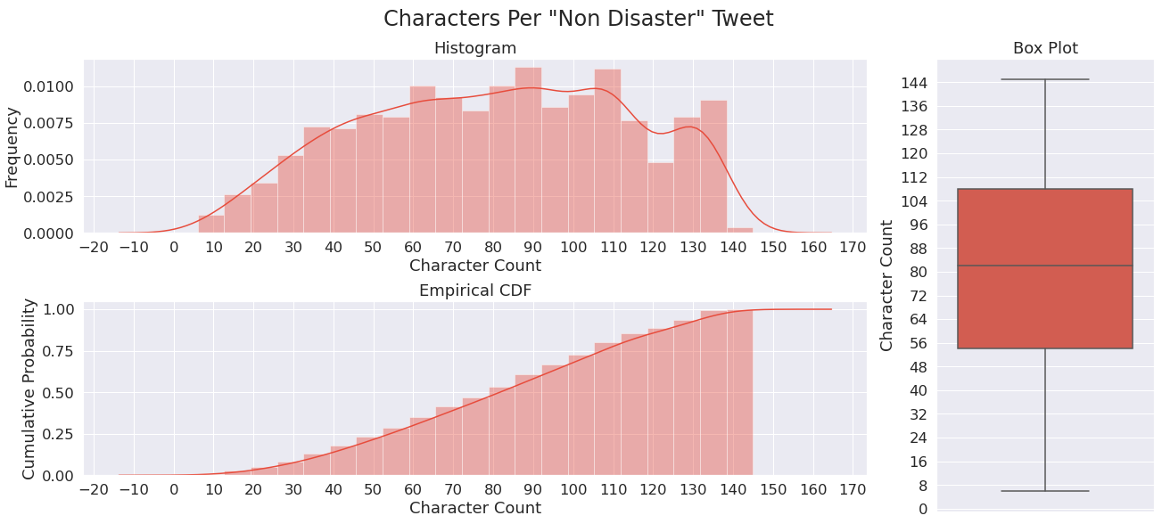
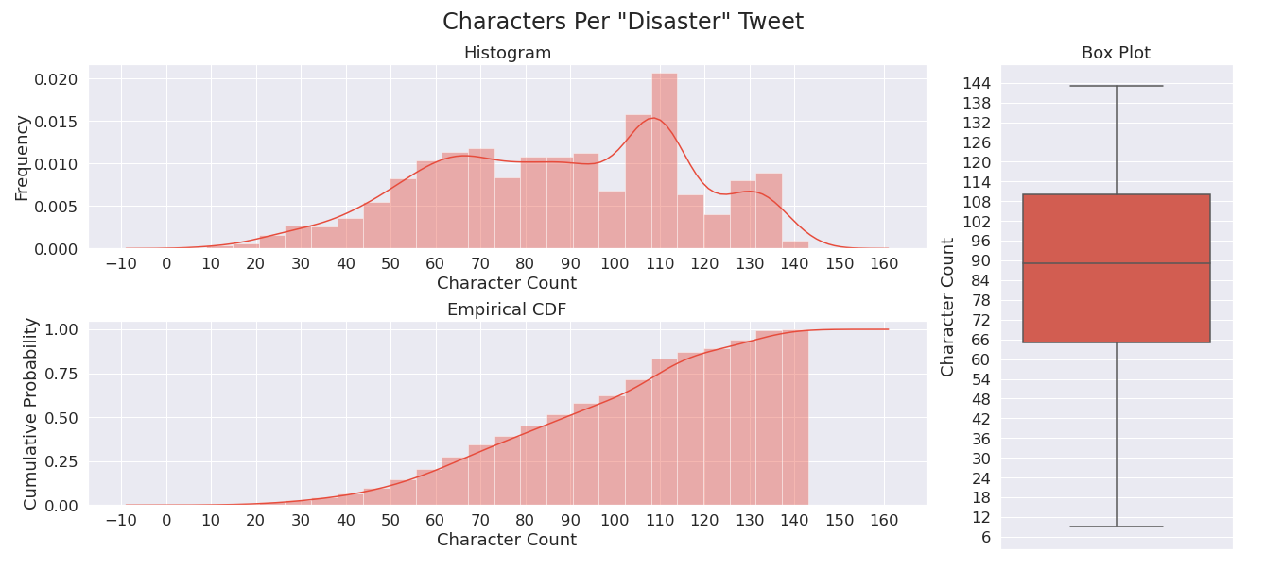
Tweet Lengths
Characters Per "Non Disaster" Tweet
THE NAME OF THE COMPANY
Characters Per "Disaster" Tweet

Slide 18
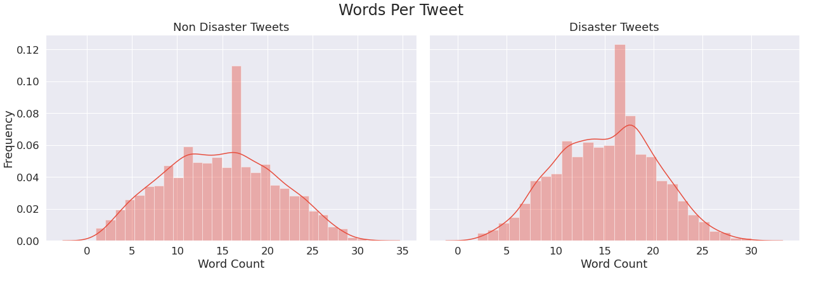
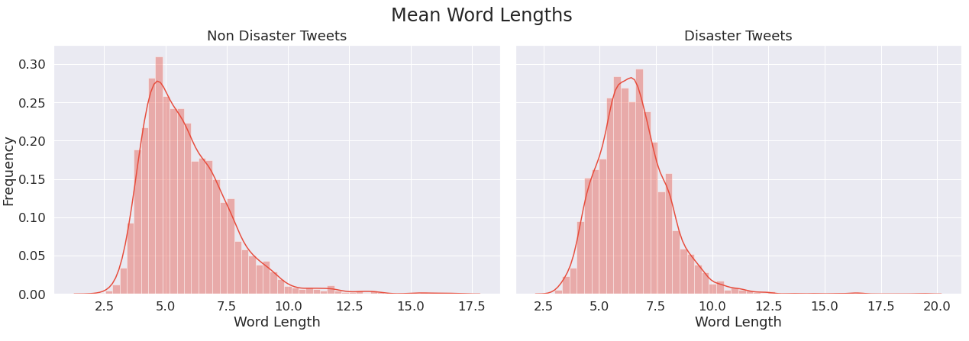
Word Counts
THE NAME OF THE COMPANY
Word Lengths

Slide 19
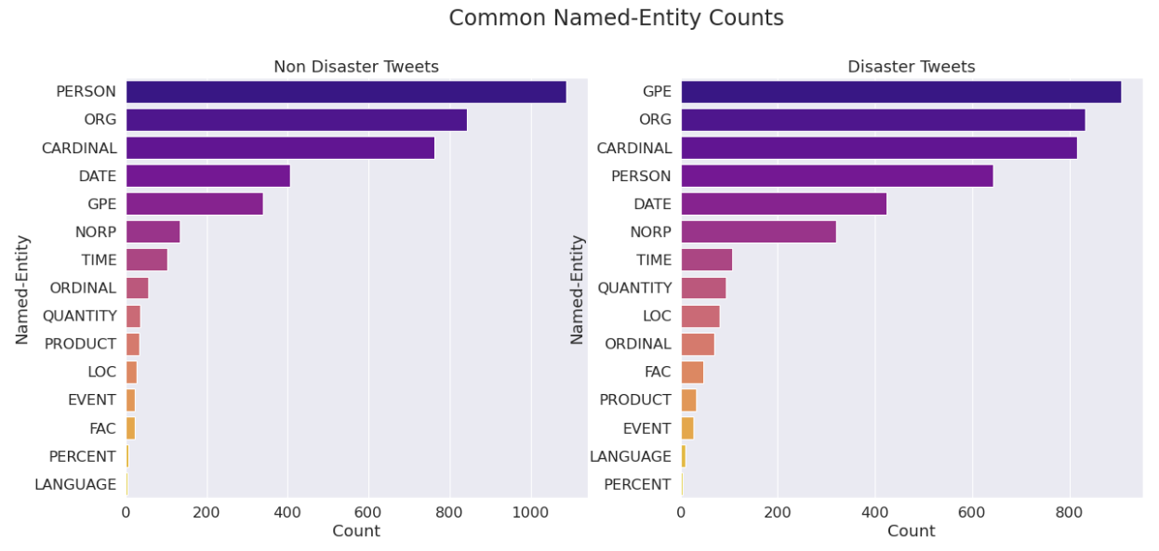
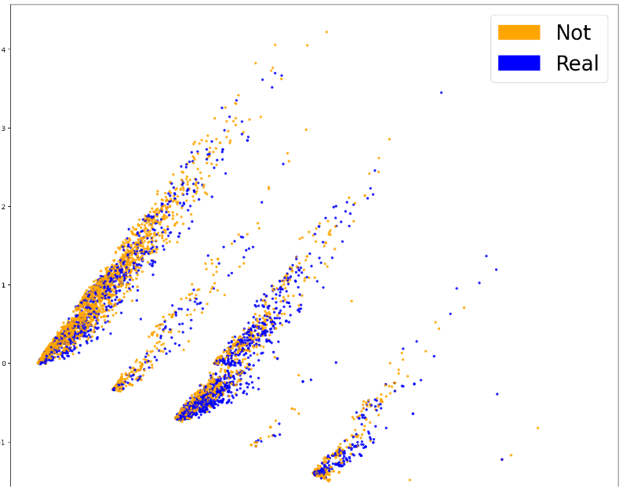
Name Entity counts
THE NAME OF THE COMPANY
Bag of Word Counts

Slide 20
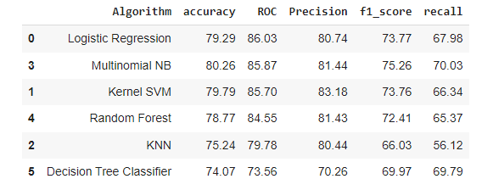
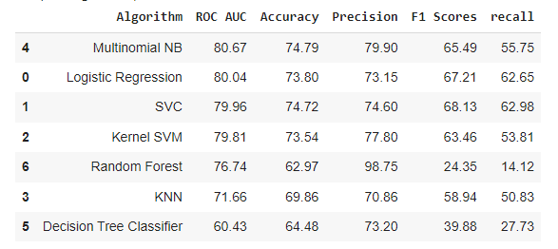
ACCURACY SCORES
Machine Learning
model_tuning
THE NAME OF THE COMPANY

Slide 21
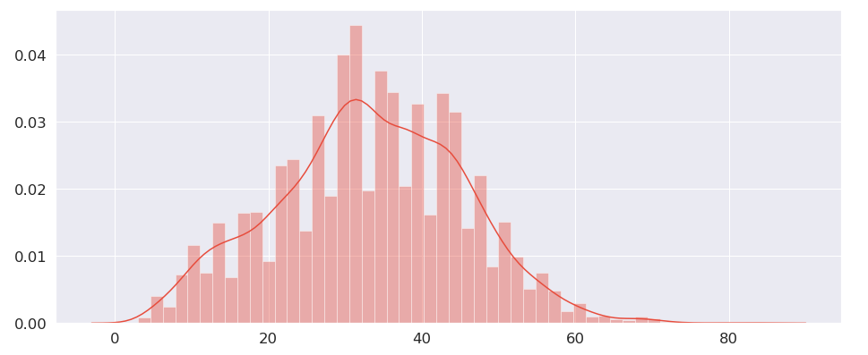
Tokenization and Formatting the Inputs
THE NAME OF THE COMPANY
I choose max len of 84 since it's the longest sentence we have here, playing with this number might get different results but the bigger you choose the slower the model will be!

Slide 22
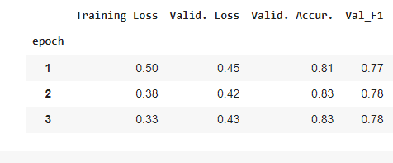
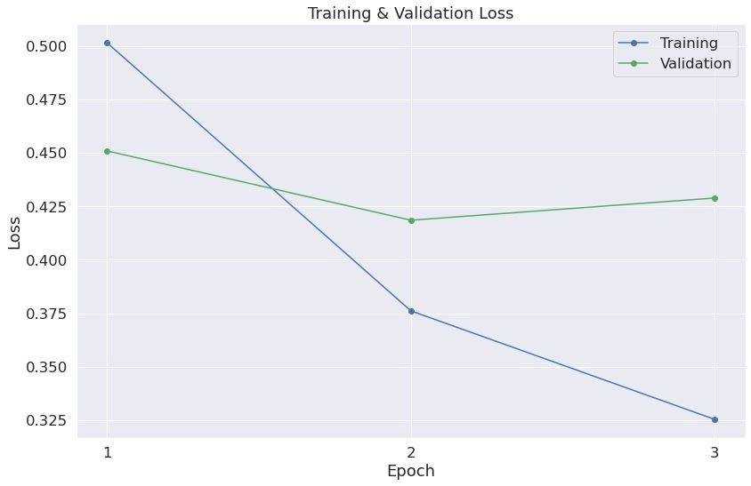
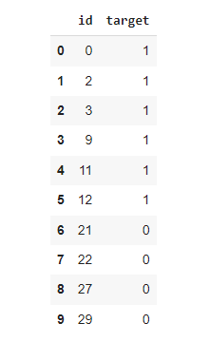
BERT Model
Final result
THE NAME OF THE COMPANY

Slide 23
Conclusion
We conclude that the BERT model outperforms with 83% than TD-IDF and other ML models for processing tweets about disasters. This is probably due to the BERT model's improved ability to capture linguistic context-specific nuance and comprehend the meaning of particular words and phrases. Our finding suggest that disaster-related tweets can be analysed and addressed using NLP models like BERT.
Future work
We will further improve our model's performance even more by tuning its hyperparameters. We could also try combining different models to improve our overall accuracy. Cross-validation techniques could be used to ensure that our model is robust and generalizable. To address the imbalance in the dataset, we will try different techniques such as oversampling or undersampling.
THE NAME OF THE COMPANY

Slide 24

THE NAME OF THE COMPANY
“Fake news travels quicker than actual news”

